Slide 1
Design Patterns
Mark Micallef

Slide 2
Motivation
Designing object-oriented software is difficult and you will not get it right the first time round
Typical decisions:
Identifying real-world objects
Factoring them into classes
Granularity issues
Interfaces and Hierarchies
Experience is an important factor in design
We can reuse experience

Slide 3
An analogy
Writing a play or novel is daunting in nature
However, novelists and playwrights rarely design a plot from scratch
Instead, they use templates/patterns:
“Tragically flawed hero”
“The Romantic Novel”
Boy meets girl, they fall in love, boy messes things up, boy looses girl, romantic gesture, boy and girl get back together
Similar approaches can be used in OO design

Slide 4

A Medical Analogy

Slide 5
Design Patterns
“Each pattern describes a problem which occurs over and over again in our environment, and then describes the core solution to that problem, in such a way that you can use this solution a million times over, without ever doing it the same way twice”
Christopher Alexander,
Architect (the type that designs buildings)

Slide 6
Design Patterns in Software
We do not design buildings but the concept still applies
When designing software, you find yourself using the same handful of techniques over and over again
Instead of thinking in terms of walls and doors, we design in terms of objects and interfaces
Design patterns allow us to reuse experience instead of re-inventing the wheel each time round

Slide 7

Simple Example
void long hash(long t) {
long ct = currentTime();
if (!(ct-t >=1000))
return old;
else
return old*9999;
}
void long hash(long t) {
long ct = currentTime();
if (ct-t < 1000)
return old;
else
return old*9999;
}
This is called the “Reverse Conditional” pattern and is aimed at improving code reability.

Slide 8
Anatomy of a Design Pattern
Pattern name
Describe a design problem, solution and consequences in a word or two
Increases our design vocabulary
Problem
Describes situations where the pattern is useful
Sometimes includes a list of conditions that must be met in order for the pattern to be useful
Solution
Describes elements that make up the design, their relationships, responsibilities and collaborations.
It is a template, not a concrete design/implementation
Consequences
Results and trade-offs of applying the pattern
Important for evaluating design alternatives

Slide 9
Design Pattern Space (1/2)
 |  | Purpose
 |  | Creational | Structural | Behavioural
Scope | Class | Factory Method | Adapter (class) | Interpreter Template Method
 | Object | Abstract Factory Builder Prototype Singleton | Adapter (object) Bridge Composite Decorator Façade Flyweigth Proxy | Chain of Responsibility Command Iterator Mediator Memento Observer State Strategy Visitor

Slide 10
Design Pattern Space (2/2)
Patterns are organised according to 2 critera:
Purpose – What does the pattern do?
Scope – What does the pattern apply to?
Purpose
Creational - concerned with the process of object creation
Structural – deal with the composition of classes or objects
Behavioural – characterise the ways in which classes or objects interact and distribute responsibility
Scope
Class – Applies primarily to classes
Relationships between classes and subclasses based on inheritance
These relationships tend to be static
Object – Applies primarily to objects
Relationships between objects which can be changed at run-time
This is not the only way to organise patterns

Slide 11
Creational Patterns

Slide 12
Creational Patterns
Creational design patterns abstract the instantiation process
They help make a system independent of how its objects are created, composed, and represented.
Main Themes:
Creational patterns encapsulate knowledge about which concrete classes the system uses.
They hide how these classes are created and put together

Slide 13
I have a problem…
I have a class called DBConnectionPool
It creates 100 database connections and farms them out to any object that needs a connection
My problem is that I am afraid that if too many of these objects are created, it will lead to needless and excessive resource usage
How can I ensure this does not happen?

Slide 14
Singleton
Intent:
Ensure a class has only one instance, and provide a global access to it.
Problem:
Some classes need to have exactly one instance
E.g. Printer spoolers, Database Connection Pools
We need to ensure that this is the case
Applicability
When there must be exactly one instance of a class
When the sole instance should be extensible by subclassing

Slide 15
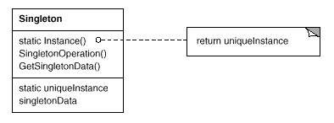
Singleton
Solution Structure:
Participants:
Singleton
defines and manages a single instance of the class

Slide 16
Singleton
public class DBConnectionPool() {
public DBConnectionPool() {
//Create connections
…
}
public Connection getConnection() {…}
}
Allowing multiple pools can lead to excessive resource consumption

Slide 17
Singleton
public class DBConnectionPool() {
private static DBConnectionPool instance = null;
public DBConnectionPool() {
//Create connections
…
}
public Connection getConnection() {…}
}
Step 1: Create a static property referring to an instance of the class and set it to null

Slide 18
Singleton
public class DBConnectionPool() {
private static DBConnectionPool instance = null;
private DBConnectionPool() {
}
public Connection getConnection() {…}
}
Step 2: Make the constructor private. This prevents creation from outside the class.

Slide 19
Singleton
public class DBConnectionPool() {
private static DBConnectionPool instance = null;
public static DBConnectionPool getInstance() {
if (instance == null)
instance = new DBConnectionPool();
return instance;
}
private DBConnectionPool() {
}
public Connection getConnection() {…}
}
Step 3: Create a static getInstance() method to provide access.

Slide 20
Singleton
To use your newly created singleton class:
public class MyApplication() {
public static void main(String[] args) {
DBConnectionPool pool;
pool = DBConnectionPool.getInstance();
}
}

Slide 21
Singleton
Consequences:
Controlled access to a sole instance: The Singleton class can have strict control on how and when a client can access the instance
Reduced name space: The alternative to using singletons is the use of global variables. This would pollute the name space.
Permits refinement of operations: The Singleton class can be subclassed. This means you can refine its behaviour as required in different circumstances.

Slide 22
I have a problem…
I am creating a content management system for news portals
Each news portal page is made up of a number of components or sections
Sections can be enabled/disabled/configured by editors
My code for rendering the HTML for such a page is turning out to be very cumbersome and unmaintainable

Slide 23
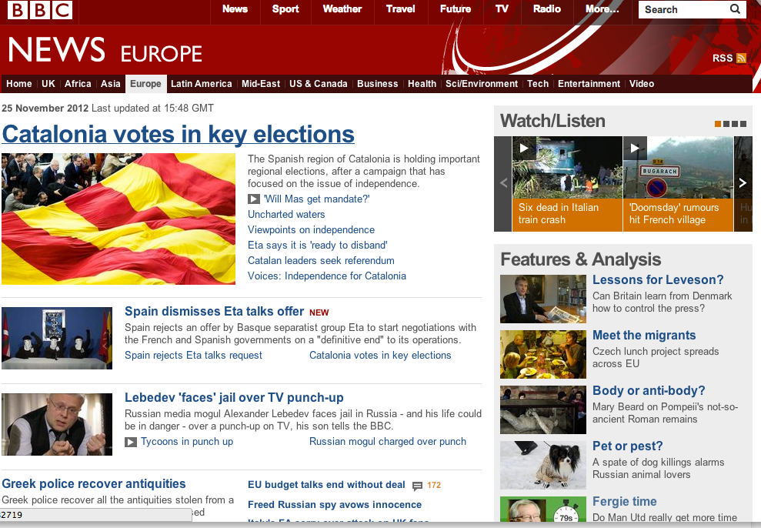
Navigation
Multimedia Content
Top Story
Features and Analysis Content
Second-Level Story
Second-Level Story

Slide 24
Builder
Intent:
Separate the construction of a complex object/product from its representation so that the same construction process can create different representations.
Problem:
You have to create a complex object
The object can take different forms depending on context
Applicability
When the algorithm for creating the object should be independent of the object or its parts
When the construction process must allow different representations for the object that’s constructed

Slide 25
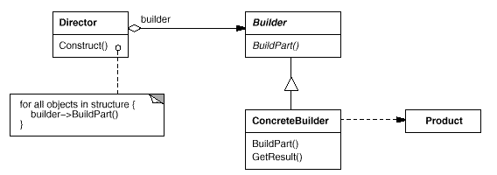
Builder
Structure:

Slide 26
Builder
Participants:
Builder
Specifies and abstract interface for creating parts of a product
ConcreteBuilder
Constructs and assembles parts of the product by implementing the builder interface
Provides an interface for retrieving the product
Director
Orchestrates the building of the product by using the Builder interface
Product
The complex object under construction

Slide 27
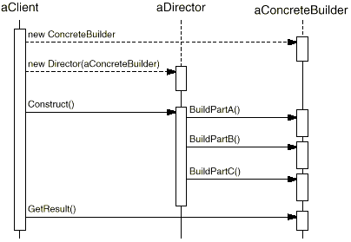
Builder
Collaborations:

Slide 28
Builder
public String buildWebPage() {
StringBuffer sb = new StringBuffer();
//Build Header
sb.append(“<html xmlns="http://www.w3.org/1999/xhtml\" xmlns:og=\"http://opengraphprotocol.org/schema/\" xml:lang=\"en-GB\”>”);
sb.append(“<head profile="http://dublincore.org/documents/dcq-html/"> <meta http-equiv="X-UA-Compatible" content="IE=8" /> <meta http-equiv="Content-Type" content="text/html; charset=utf-8" /> <title>BBC News - Europe</title> <meta name="Description" content="Get the latest European news from BBC News in Europe: headlines, features and analysis from BBC correspondents across the European Union, EU, and the rest of Europe."/> <meta name="OriginalPublicationDate" content="2012/11/25 16:13:24"/> <meta name="UKFS_URL" content="/news/world/europe/"/> <meta name="Headline" content="INDEX "/> <meta name="IFS_URL" content="/news/world/europe/"/> <meta name="Section" content="Europe"/> <meta name="contentFlavor" content="INDEX"/> <meta name="CPS_ID" content="10059386" /> <meta name="CPS_SITE_NAME" content="BBC News" /> <meta name="CPS_SECTION_PATH" content="World/Europe" /> <meta name="CPS_ASSET_TYPE" content="IDX" /> <meta name="CPS_PLATFORM" content="HighWeb" /> <meta name="CPS_AUDIENCE" content="Domestic" />”);
….
return sb.toString();
}

Slide 29
Builder
Step 1: Create Product representation.
public class Page{
public String getHTML();
}

Slide 30
Builder
public abstract class PageBuilder {
public abstract Page getPage();
public abstract void buildHeader();
public abstract void buildTopStory();
public abstract void buildMultiMedia();
public abstract void buildAnalysis();
…
}
Step 2: Create abstract builder interface.

Slide 31
Builder
public class BBCPageBuilder extends PageBuilder {
public Page getPage() {…}
public void buildHeader() {…};
public void buildTopStory(){…};
…
}
public class CNNPageBuilder extends PageBuilder {
public Page getPage() {…}
public void buildHeader() {…};
public void buildTopStory(){…};
…
}
Step 3: Create concrete builder(s)

Slide 32
Builder
Public class Director {
public Director(PageBuilder builder) {..}
public void construct() {
builder.buildHeader();
builder.buildTopStory();
if (contentAvailable()) builder.buildMultiMedia();
}
}
Step 4: Construct director

Slide 33
Builder
Public class CNNClient {
public static void main(String[] args) {
Builder builder = new CNNPageBuilder();
Director director = new Director(builder);
director.construct();
Page myPage = builder.getPage();
}
}
Step 5: Build a client

Slide 34
Builder
Consequences:
Lets you vary a product’s internal representation. Since the Builder object provides the Director with an abstract interface, the internal representation of objects may be different depending on the implementation.
Isolates code for construction and representation. Clients do not really need to know anything about the classes that define the product’s internal structure. Such classes do not appear in the Builder’s interface.
Gives you finer control over the construction process. Since the builder provides methods for constructing an object step by step, the director has a higher degree of control than that of other creational patterns.

Slide 35

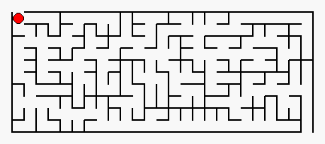
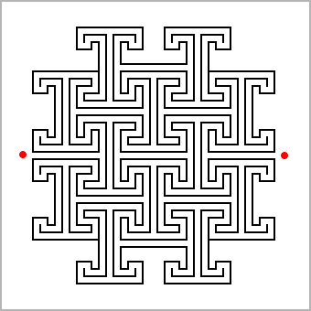
I have a problem…

Slide 36
I have a problem…
I am creating a maze-based game
I want to support different types of mazes
I want to be able to add new mazes in future
How can I do this?

Slide 37
I have a problem
public void init(String mazeType) {
if (mazeType == “basic”) {
Maze maze = new Maze();
maze.addCorridor(0,0,1,10);
…
} else if (mazeType == “circular”) {
Maze maze = new Maze();
maze.addCirculrWall(0,0,1,5,180);
…
} else if …
…
}
Messy and difficult to add support for new mazes

Slide 38
Factory Method
Intent:
Define an interface for creating an object, but let subclasses decide which class to instantiate.
Problem:
Use of abstract classes, interfaces and inheritance is useful in OO but can become convoluted.
Object creation code can clutter your system code when it is not really relevant to understanding the problem being solved.
Applicability
When a class can’t anticipate the class of objects it must create
When classes delegate responsibility to one of several helper subclasses

Slide 39
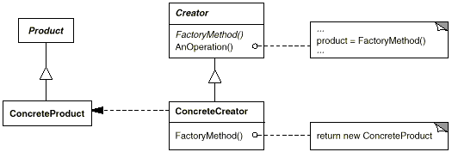
Factory Method
Structure:
Creator relies on its subclasses to define the factory method so that it returns an instance of the appropriate ConcreteProduct

Slide 40
I have a problem
public void init(String mazeType) {
if (mazeType == “basic”) {
Maze maze = new Maze();
maze.addCorridor(0,0,1,10);
…
} else if (mazeType == “circular”) {
Maze maze = new Maze();
maze.addCirculrWall(0,0,1,5,180);
…
} else if …
…
}

Slide 41
Factory Method
public interface Maze {
public String type;
public void paint();
}
Step 1: Create product interface of abstract class.

Slide 42
Factory Method
public class BasicMaze implements Maze{
public String type = “Basic”
public void paint() {…}
}
Step 2: Create concrete products.
public class CircularMaze implements Maze{
public String type = “Circular”
public void paint() {…}
}

Slide 43
Factory Method
Public class MazeCreator {
//Factory Method
public Maze createMaze(String type) {
//Determine which creator to use
MazeCreator creator = findCreatorForType(type);
//Create and return maze
return creator.createMaze();
}
}
Step 3: Create Creator class. Can be abstract or concrete.

Slide 44
Factory Method
public class BasicMazeCreator extends MazeCreator{
public Maze create() {
BasicMaze maze = new BasicMaze();
//Configure maze
…
//Return maze
return maze;
}
}
Step 4: Create product creators.

Slide 45
Factory Method
public class CircularMazeCreator extends MazeCreator{
public Maze create() {
CircularMaze maze = new CircularMaze();
//Configure maze
…
//Return maze
return maze;
}
}
Step 4: Create product creators.

Slide 46
Factory Method
public class MazeGame {
public static void main(String[] args) {
String type = args[0];
MazeCreator creator = new MazeCreator();
Maze maze = creator.createMaze(type);
}
}
Step 5: Create mazes.

Slide 47
Factory Method
Consequences:
Eliminates the need to bind application-specific classes into your code. Since you only deal with interfaces/abstract classes in terms of products, you can literally plug in any object which implements the interface at runtime.
Allows for elegant flexible use of sub-classes. Since you are delegating object creation, your code is more elegant and can make efficient use of subclasses.

Slide 48

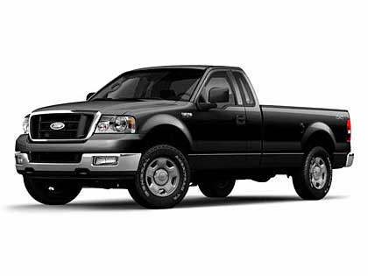

I have a problem…

Slide 49
I have a problem…
I am writing a system which controls a factory supply chain
The factory produces different kinds of vehicles
Each vehicle has its own set of parts
Creating an object representation of each vehicle is complicated and involves a family of objects
I want to be able to add more vehicles in future

Slide 50
I have a problem…
Car
CarChasis
MediumWheel
DomesticEngine
SmallSparkPlug

Slide 51
I have a problem…
Bus
BusChasis
LargeWheel
IndustrialEngine
LargeSparkPlug

Slide 52
Abstract Factory Method
Intent:
Provide an interface for creating families of related or dependent objects without specifying their concrete classes.
Problem:
You need to assemble complex families of objects.
Applicability
When a system needs to be independent of how its products are created, composed and represented.
When a system should be configured with one of multiple families of products.
When a family of related product objects is designed to work together and you need to enforce this.
You want to provide a class library of products and only want to reveal their interfaces, not their implementations

Slide 53
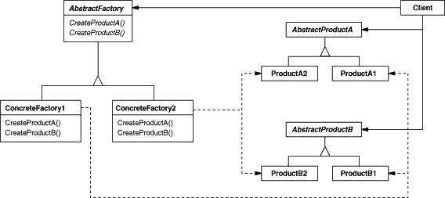
Abstract Factory Method
Structure:

Slide 54
Abstract Factory Method
Participants:
AbstractFactory – declares an interface of operations that create abstract product objects.
ConcreteFactory – implements the AbstractFactory operations to create concrete product objects.
AbstractProduct – declares an interface for a type of product object.
ConcreteProduct – implements the AbstractProduct interface and defines a product object to be created by the corresponding concrete factory.
Client – uses only interfaces delclared by AbstractFactory and AbstractProduct classes.

Slide 55
Abstract Factory Method
Step 1: Create abstract product structures.
Vehicle
<<interface>>
Chasis
<<interface>>
Wheel
<<interface>>
Engine
<<interface>>
SparkPlug
<<interface>>

Slide 56
Abstract Factory Method
Chasis
<<interface>>
Step 2: Create concrete components.
CarChasis
BusChasis
TruckChasis
Wheel
<<interface>>
SmallWheel
LargeWheel

Slide 57
Abstract Factory Method
VehicleFactory
<<abstract>>
createVehicle()
createChasis()
createWheels()
createEngine()
Step 3: Create Factories
CarFactory
createChasis()
createWheels()
createEngine()
BusFactory
createChasis()
createWheels()
createEngine()
TruckFactory
createChasis()
createWheels()
createEngine()

Slide 58
Abstract Factory Method
public class VehicleFactoryClient {
public static void main(String[] args) {
String type = args[0];
VehicleFactory factory;
if (type == “Car”) {
factory = new CarFactory();
} else {…}
factory.createVehicle();
}
}
Step 5: Use the factories as required.

Slide 59
Abstract Factory Method
Consequences:
Simplifies creation of object families for client. Clients simply call the factory and everything is done behind the scenes.
Isolates concrete classes. Clients need never know the implementation details of concrete classes because they only interact with interfaces.
Makes exchanging product families easy. To produce a different family of objects, simply use a different ConcreteFactory.
Promotes consistency amongst products. All products fit a particular template.
Supporting new kinds of products is difficult. If a product does not fit into the template easily, the pattern does not allow it to be supported. E.g. imagine starting to produce furniture instead of cars.

